Slide 1
FLC-PCR Update 5-28-2020
James Ferguson

Slide 2
FLC-PCR Software Updates
Fixed a step timing issue
Added data logging for graphing
Updated old Debug UI and logger to somewhat work for PID tuning with the new software
Added NAN checking and avoidance for temperature
Added folders to file save load

Slide 3
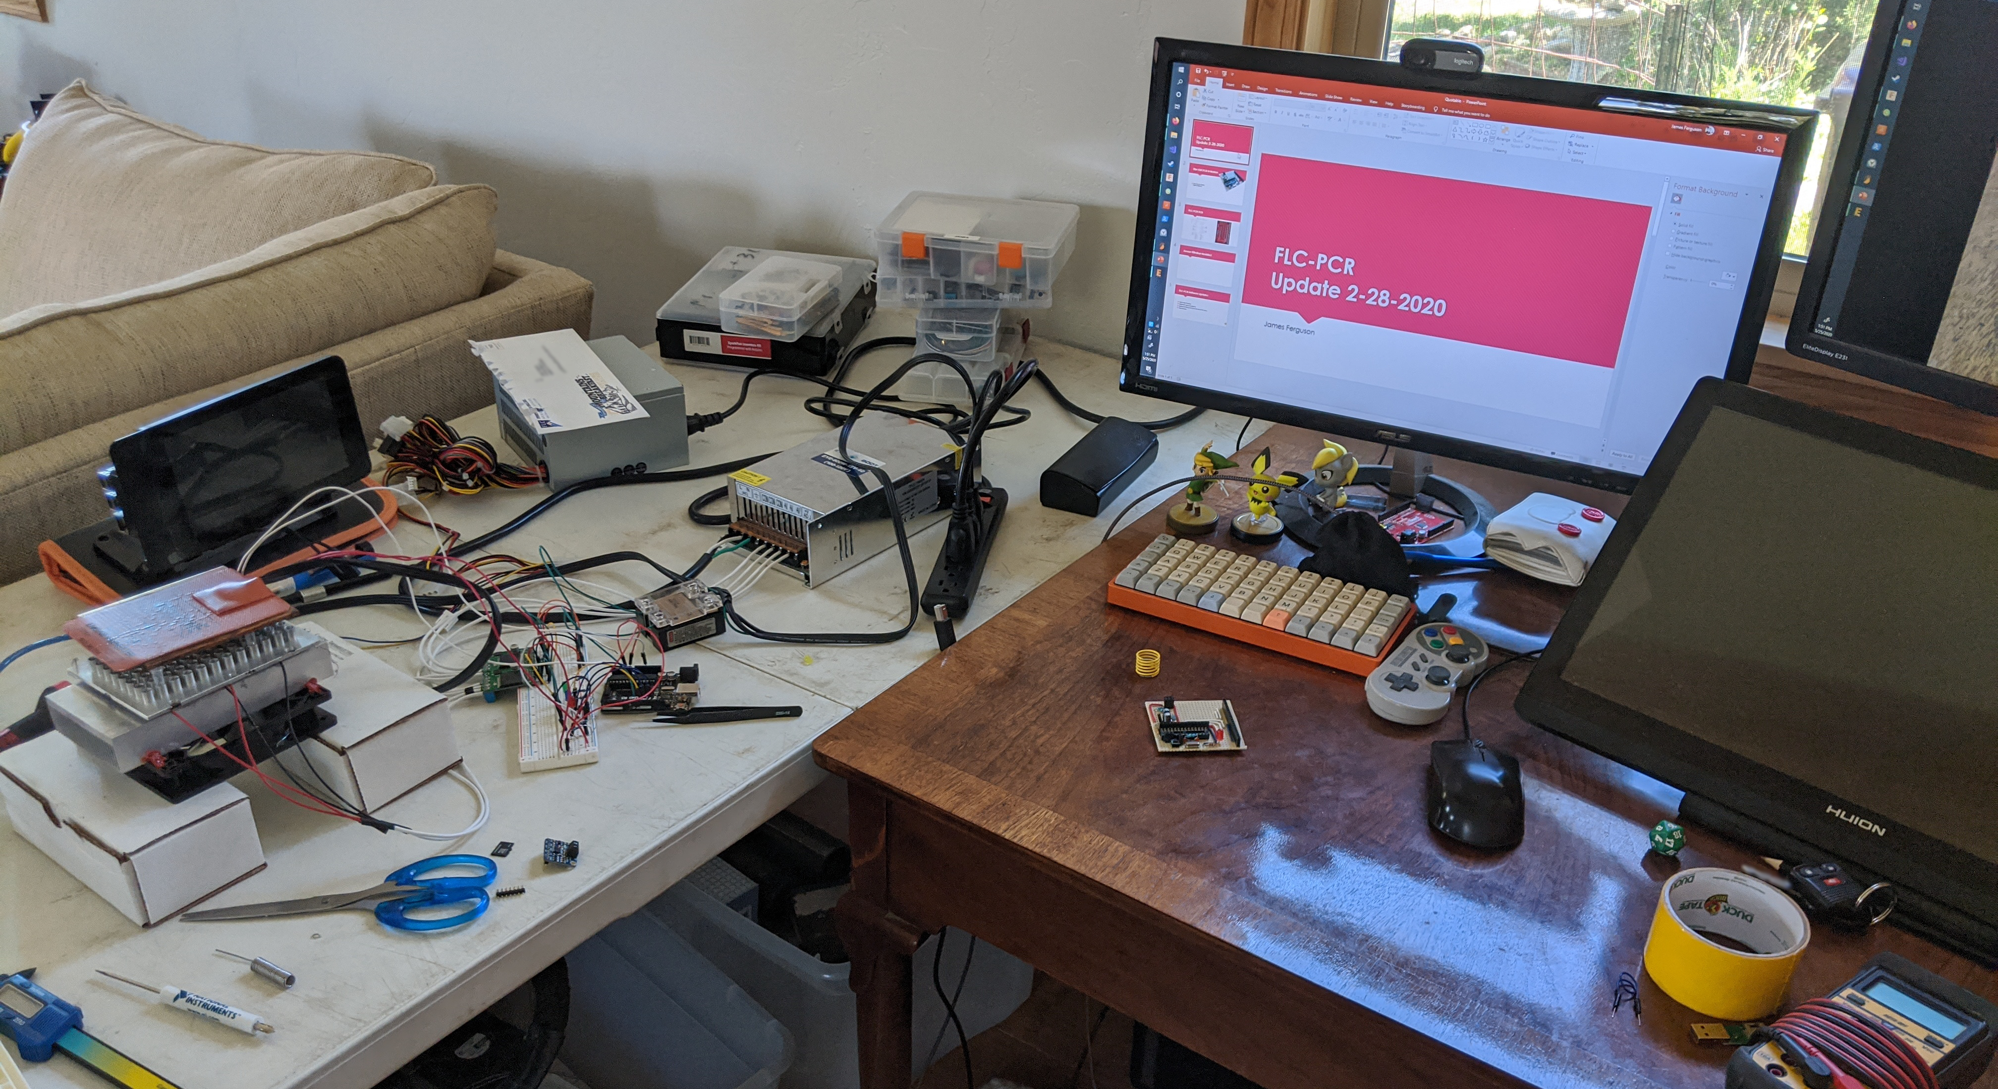
Acquired FLC-PCR Hardware and Setup

Slide 4
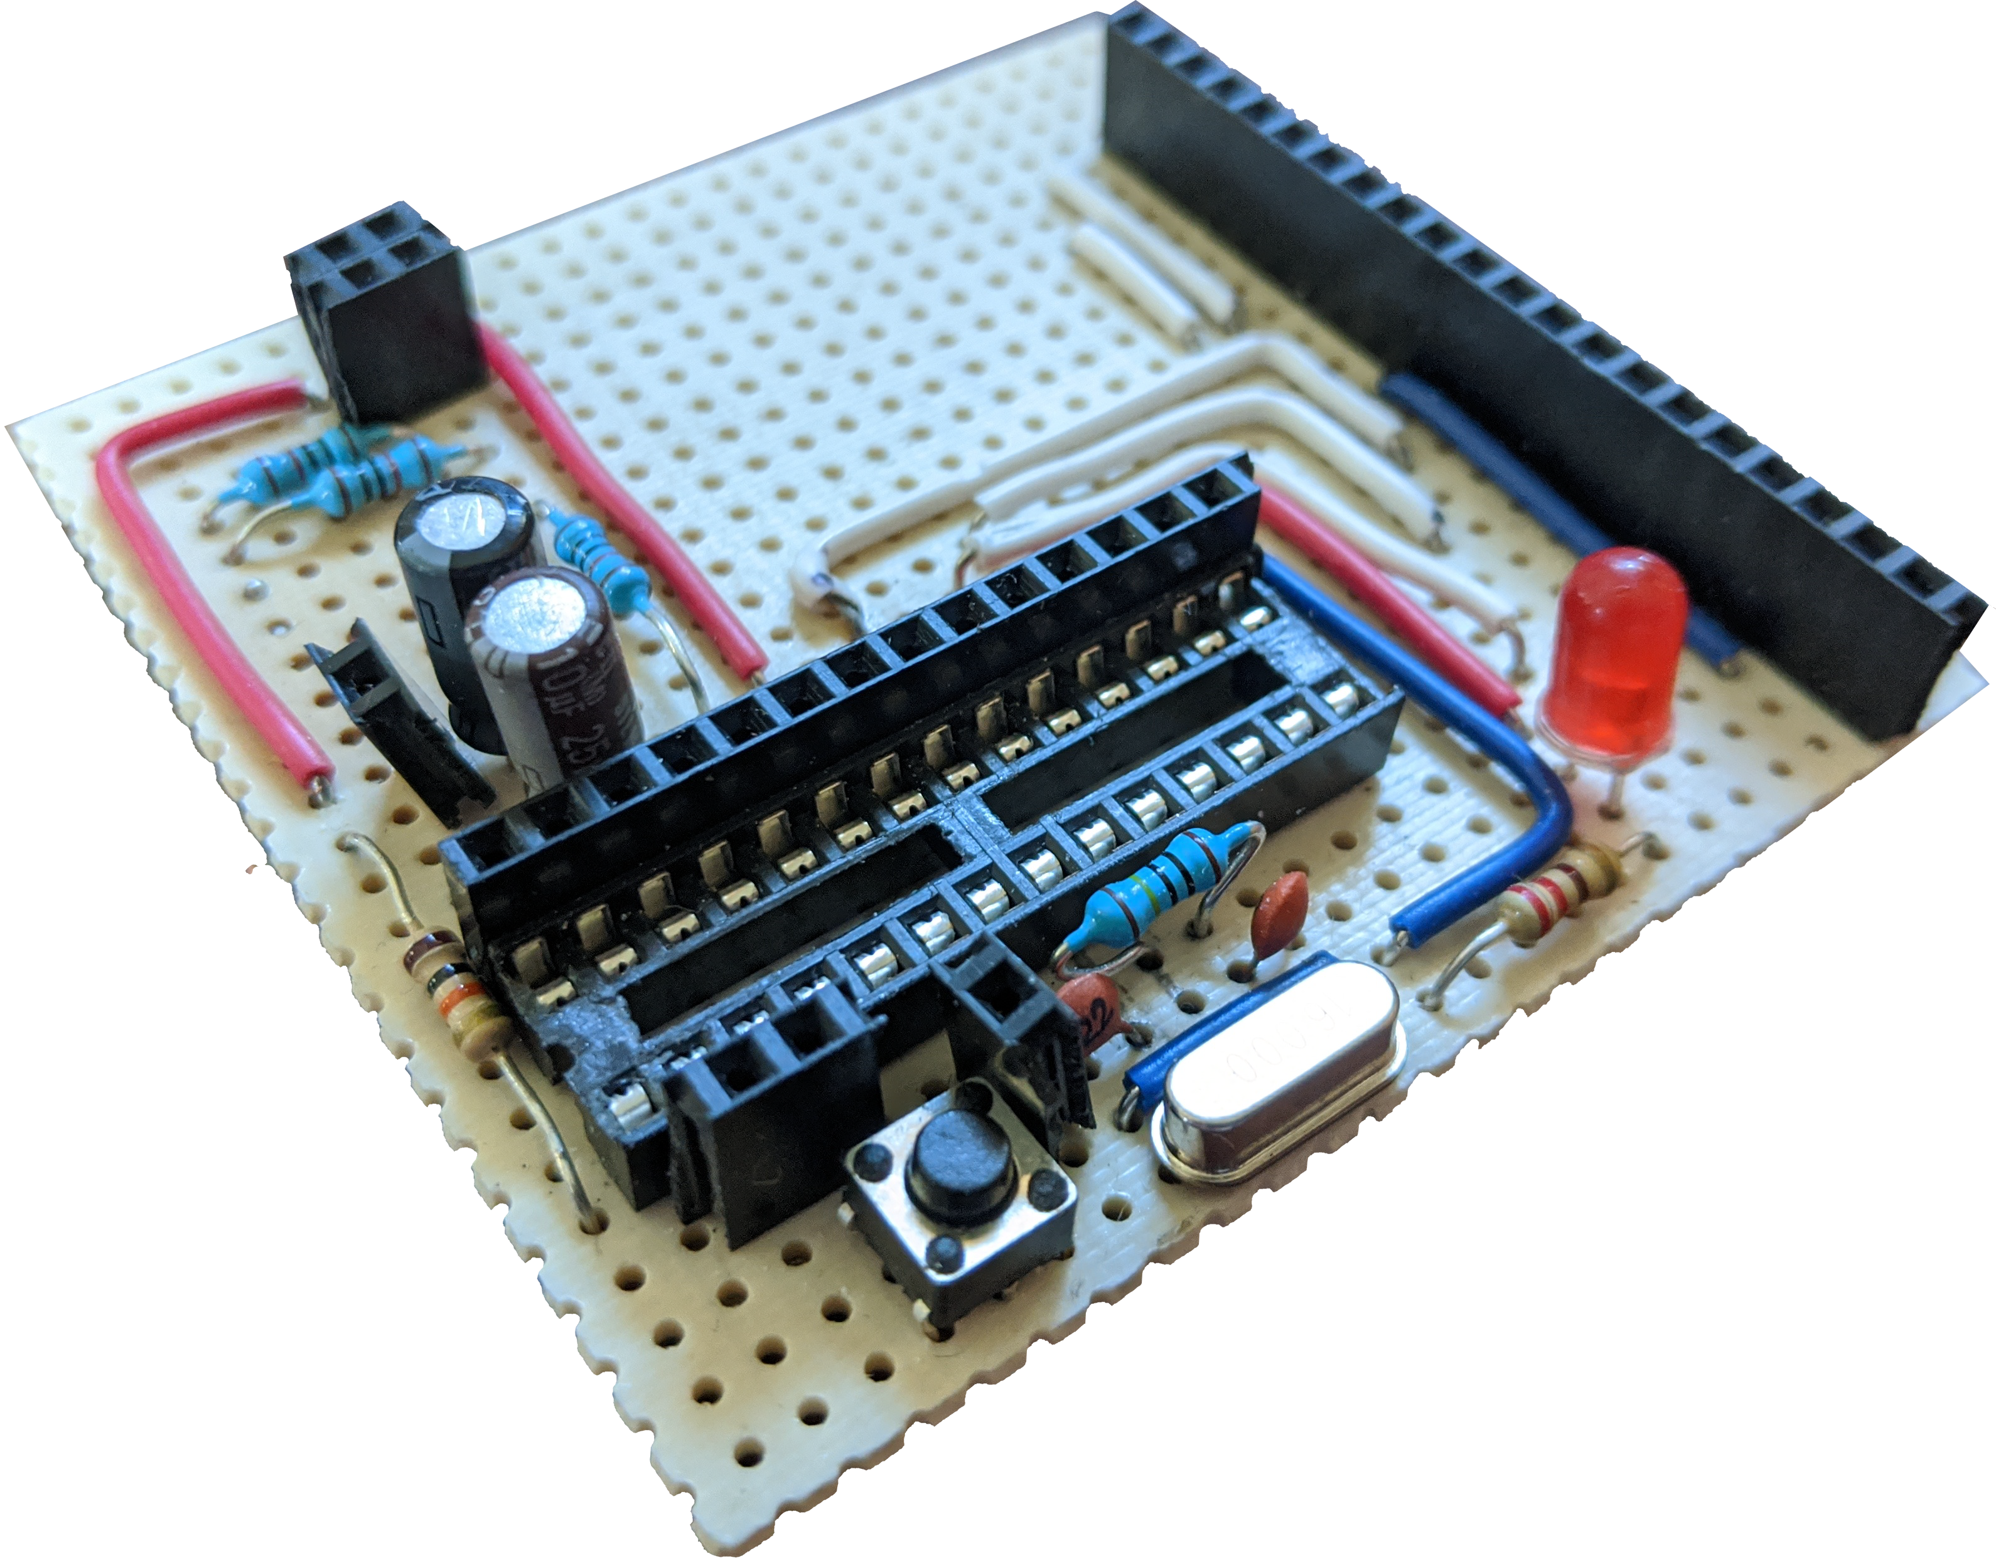
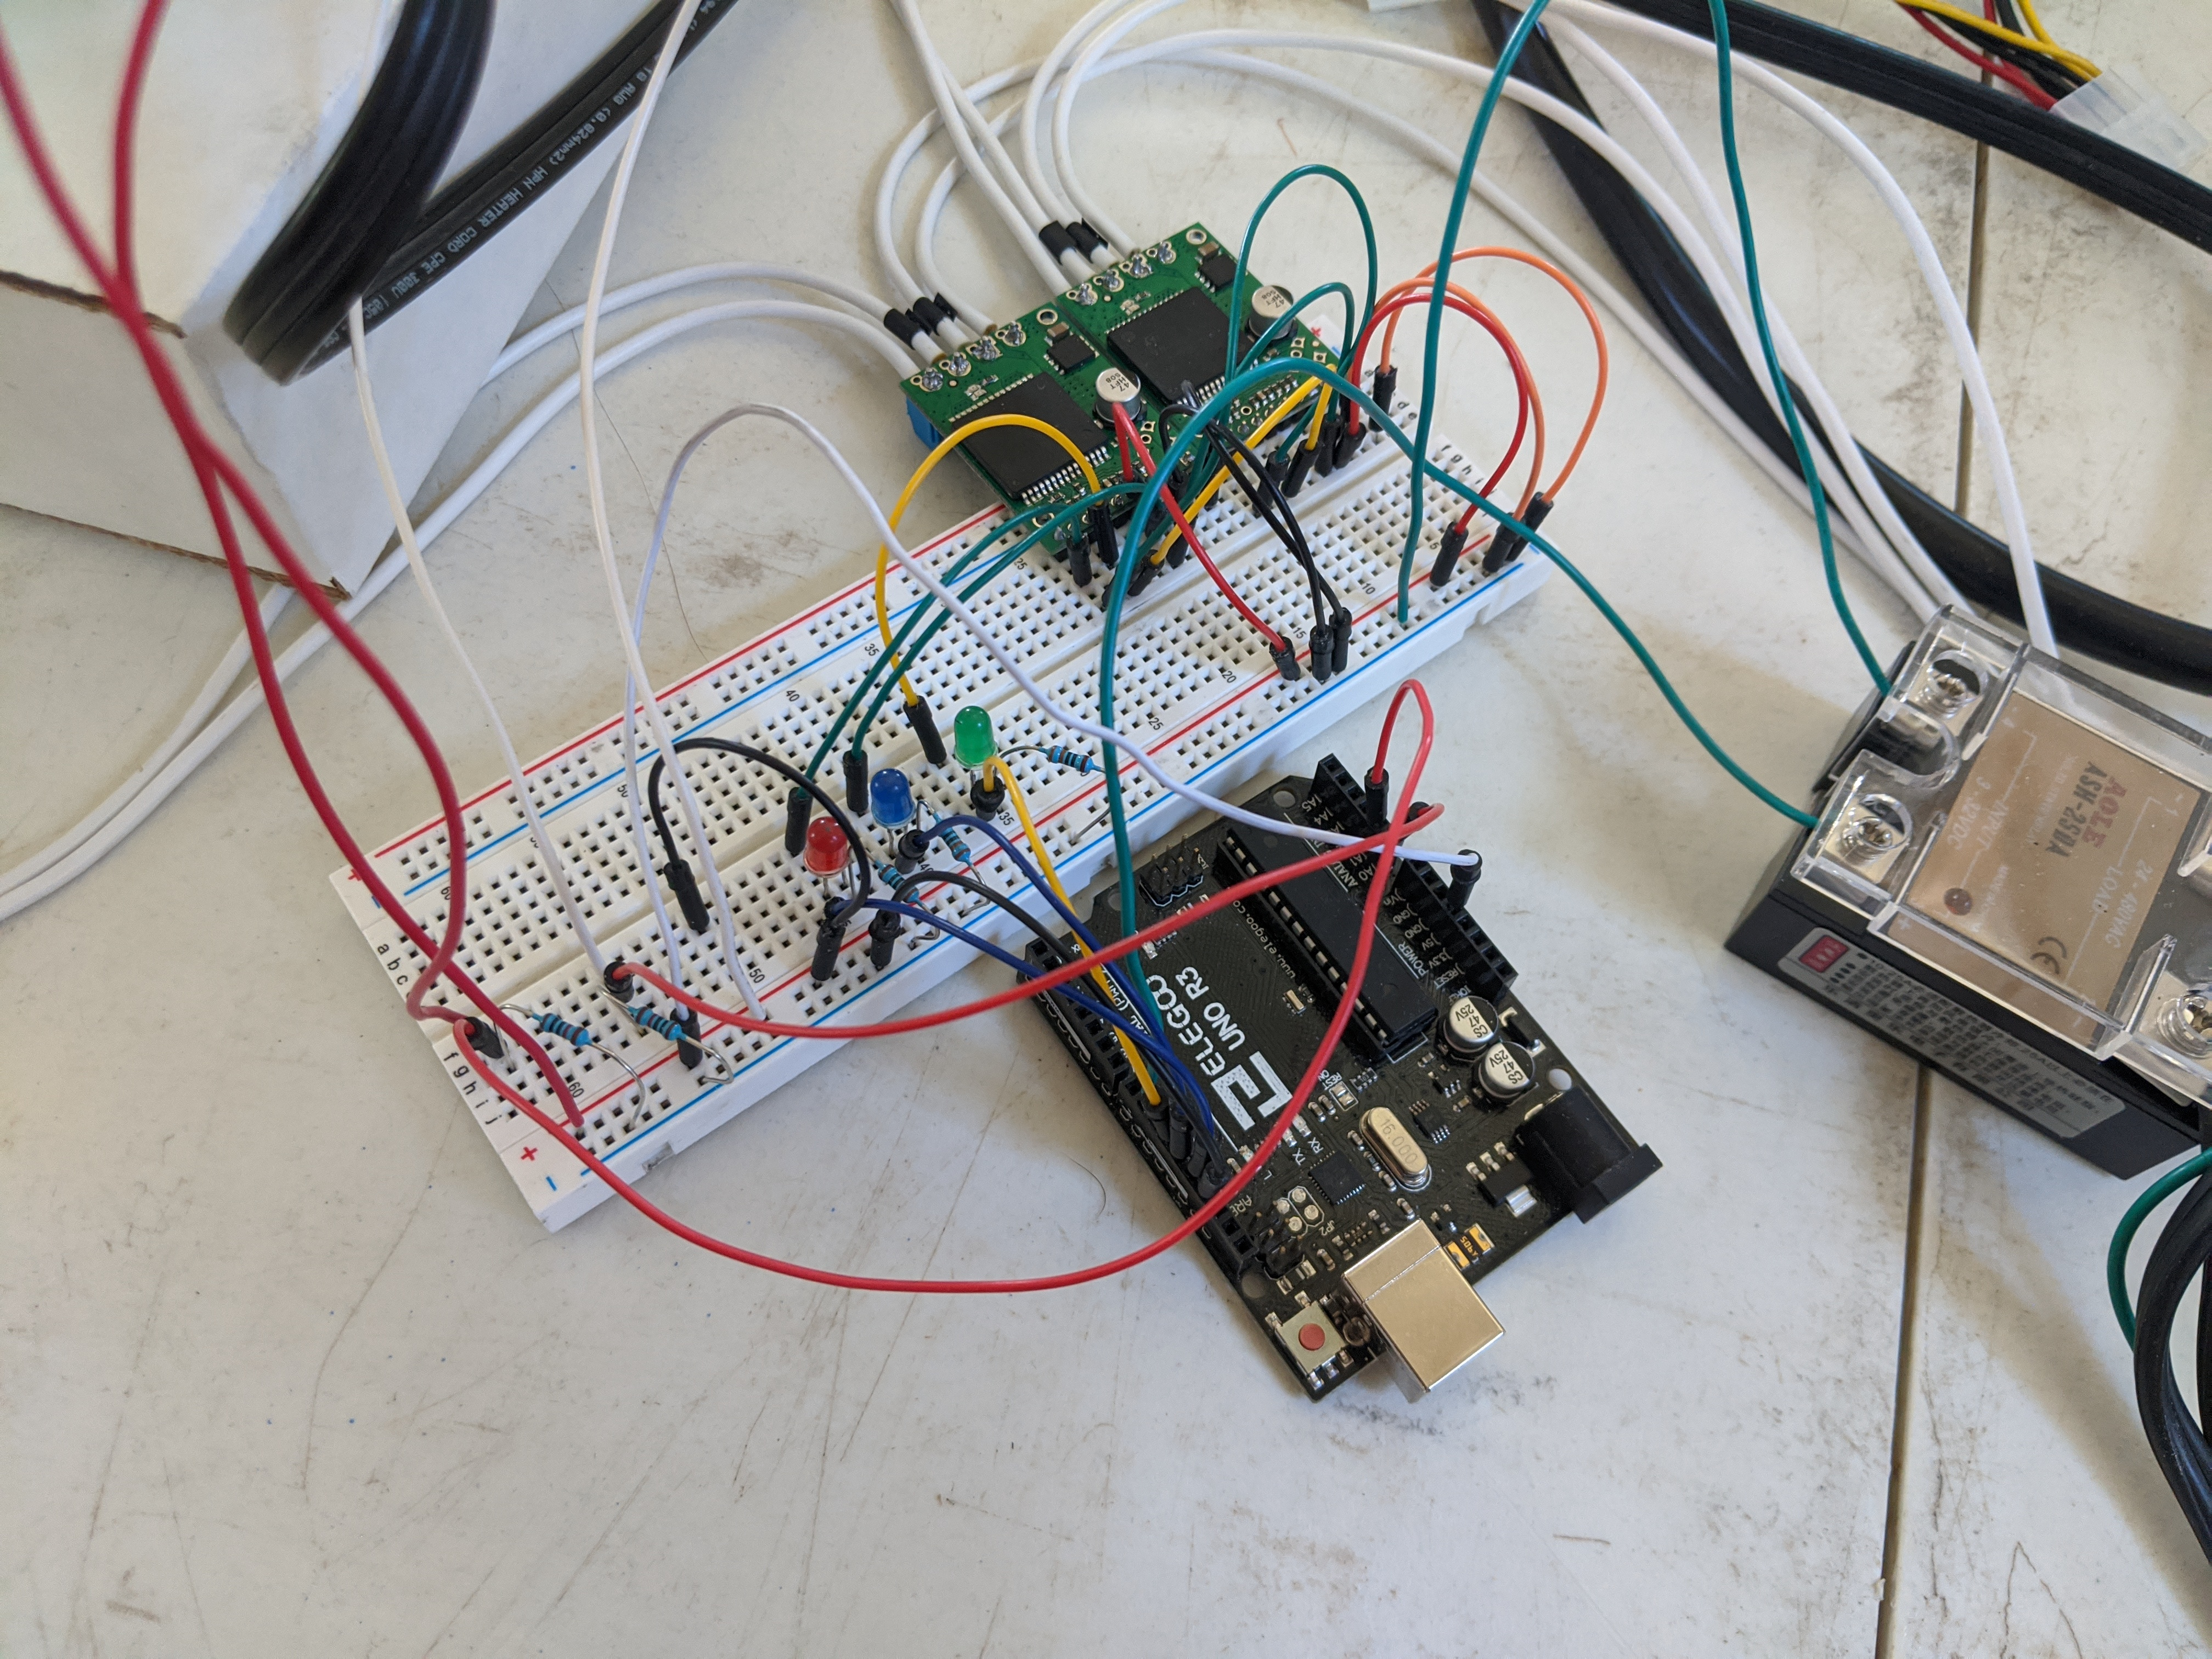
The Old PCB is Broken
Serial Communication Stability Problems
Board no longer current driver signals grounded seemed to randomly go low
Moved to bread bord temporarily and noted problems disappear

Slide 5
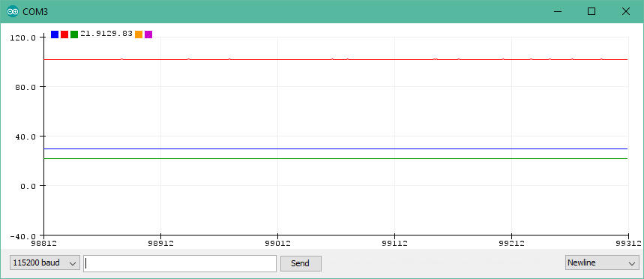
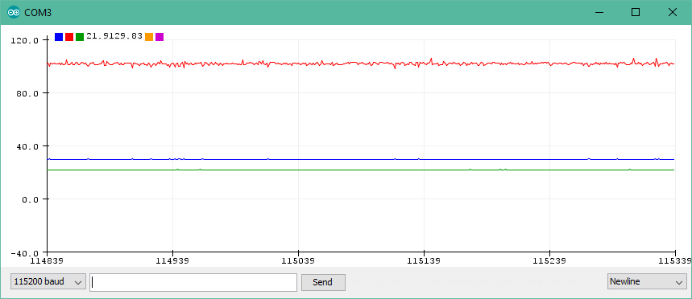
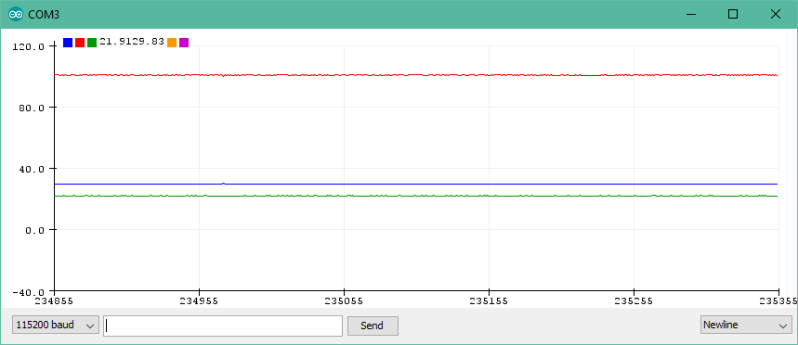
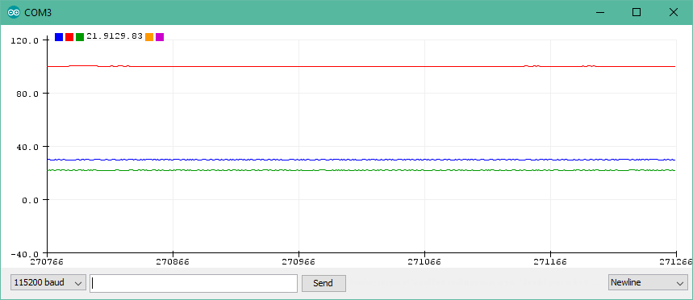
Sensor Filtration Revisited
1.59Hz Low Pass Filter 10kΩ & 10uF
2 weighted average of the current and last value filters at Sensor In and PWM Out
PSU off
PSU on
PSU on Hardware Filter
PSU on Software Filter

Slide 6
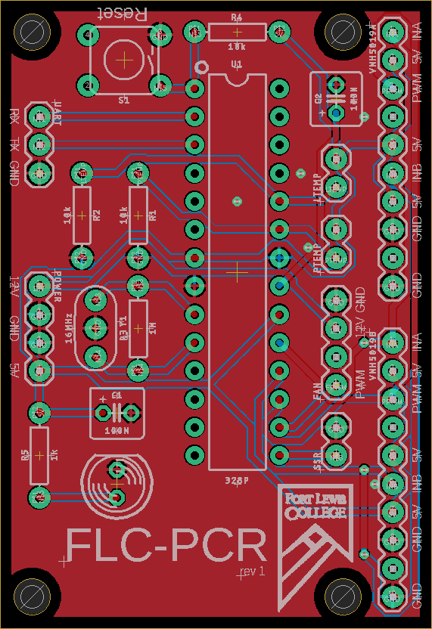
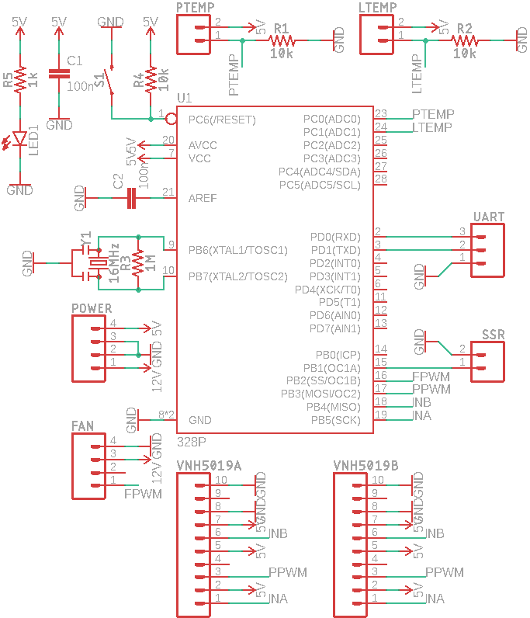

FLC-PCR PCB
rev 1
Made with Autodesk EAGLE
38.72mm x 56.50mm
2 layer, all THP component design
5 PCB’s where ordered from PCBWay costing a total of $24.00

Slide 7
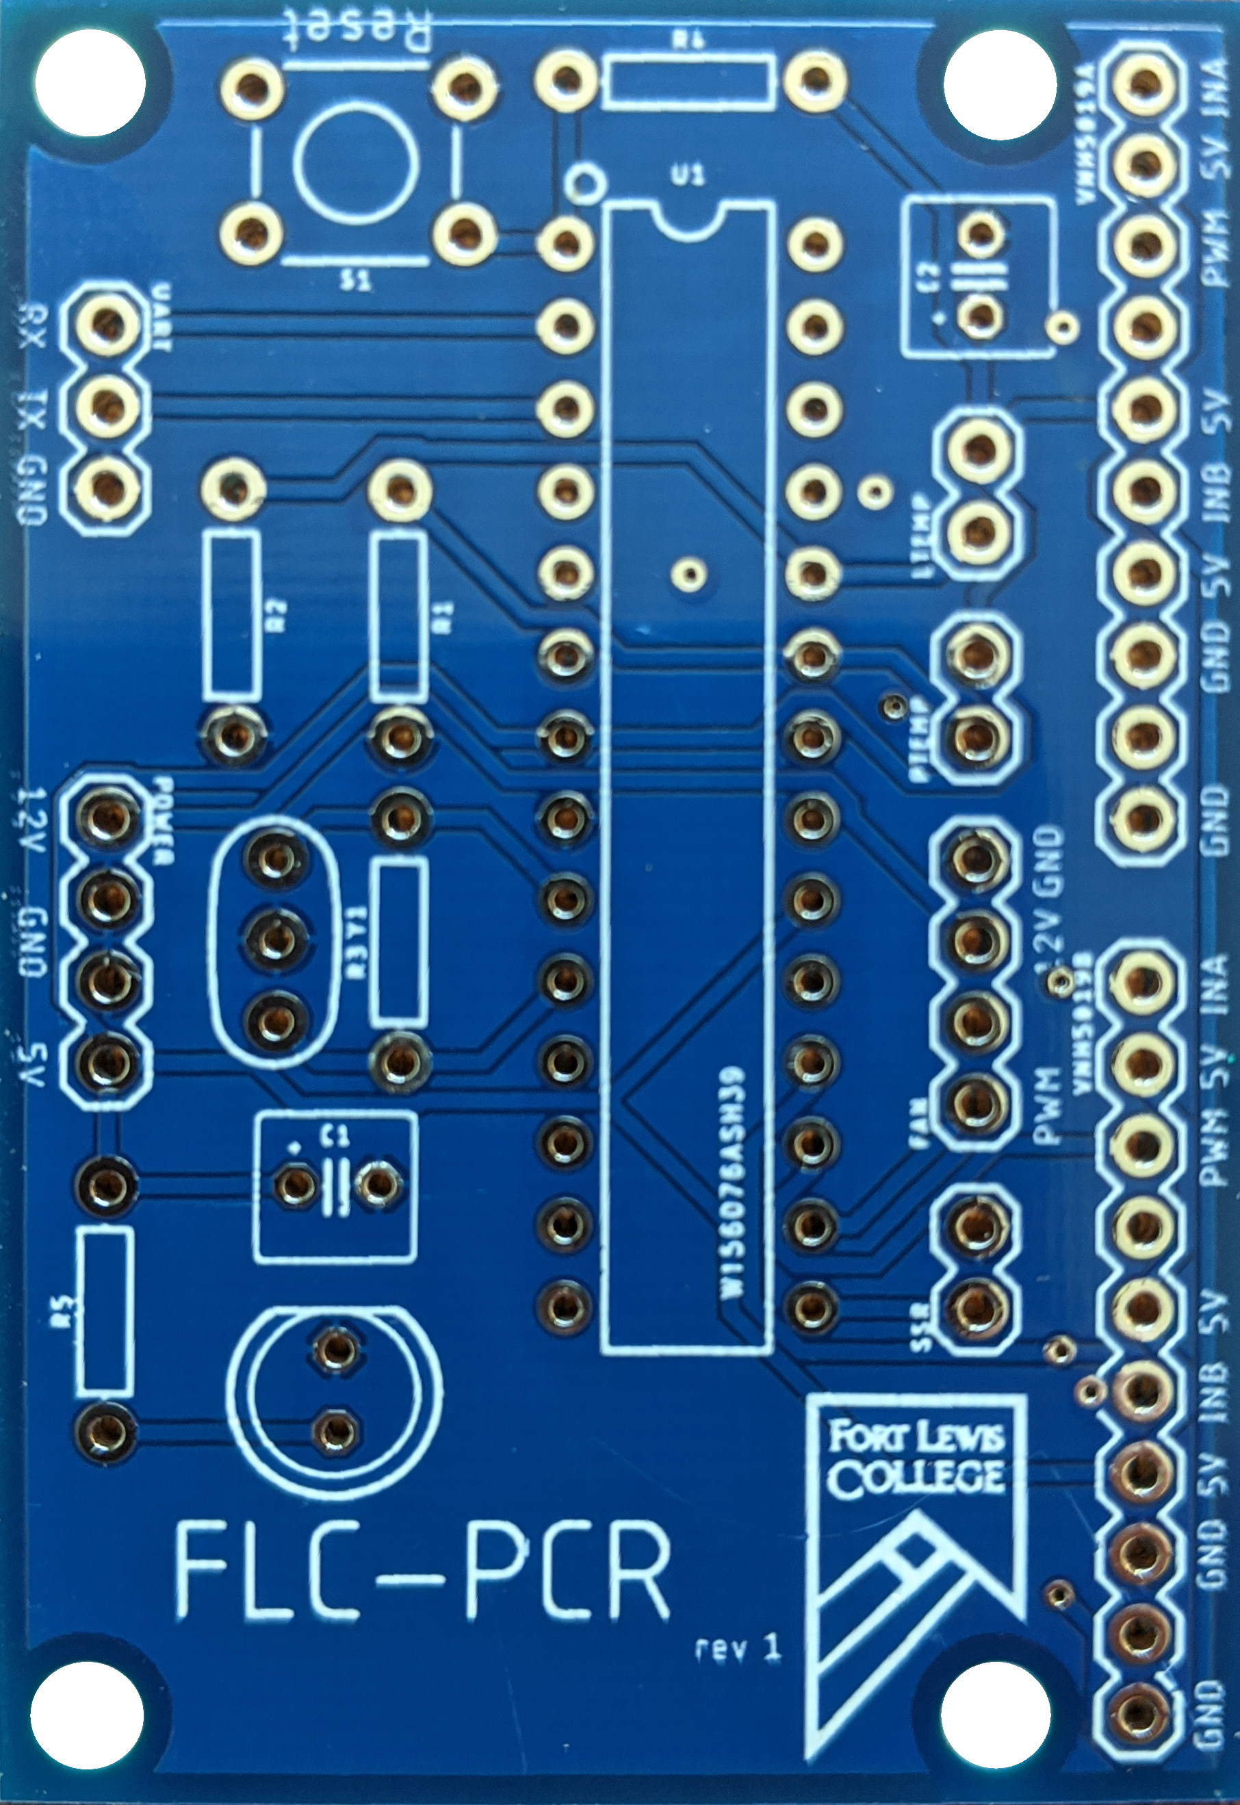
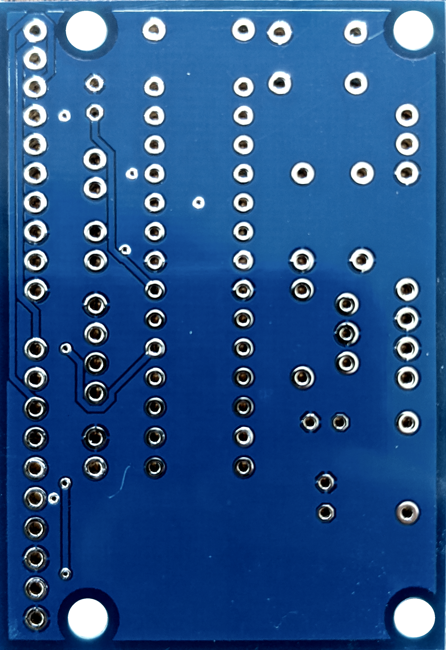
PCBs Arrived Today!
Checked for continuity, Matches Design.
Silkscreen Font was not consistent with the design for non vectorized text.
Part values where not printed.

Slide 8
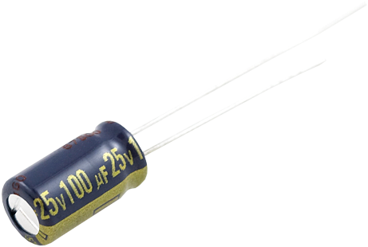
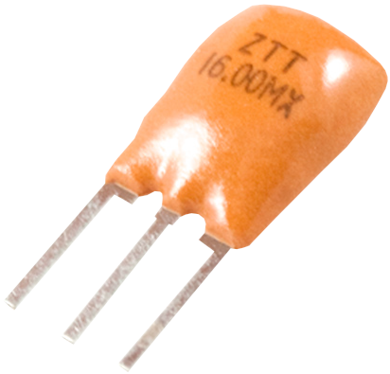
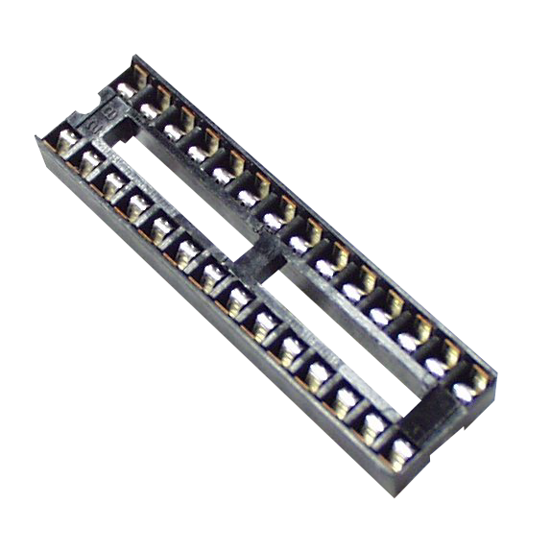
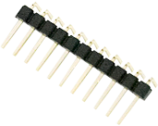
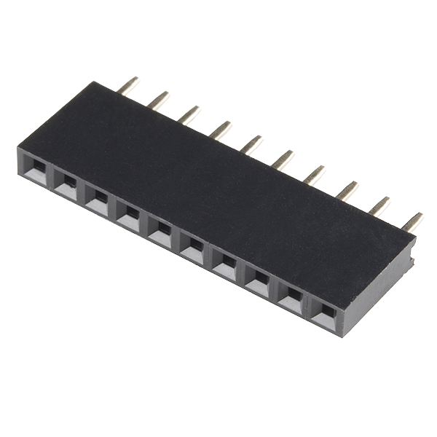
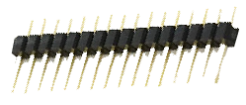
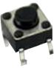
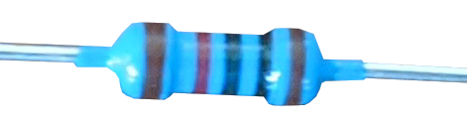
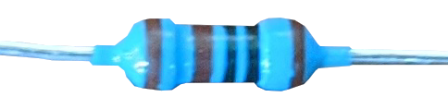
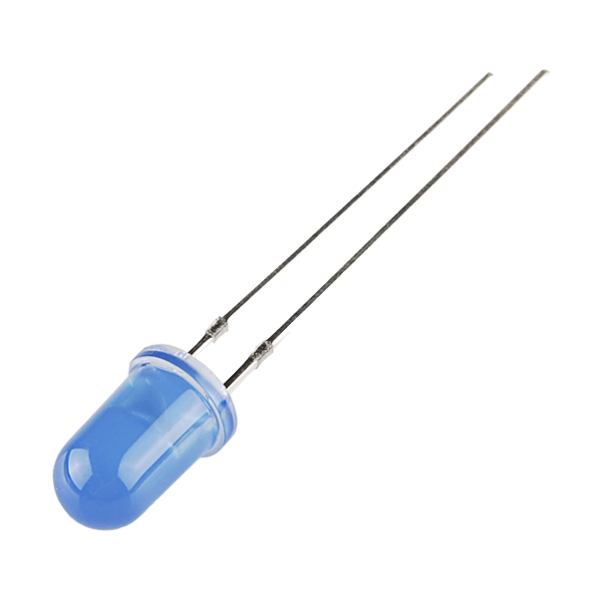
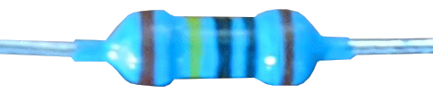
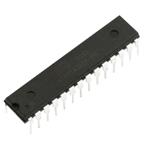
Bill of Materials
Item | Amount | Unit Price | Image
100nF Capacitor | 2 | $0.35
16MHz Resonator | 1 | $0.95
DIP Sockets Solder Tail - 28-Pin | 1 | $0.95
Break Away Male Headers - Right Angle | 1 | $1.95
Header - 10-pin Female | 2 | $0.50
Break Away Male Headers – Straight | 1 | $1.50
6mm Push Button | 1 | $-
10kΩ Resistor | 3 | $-
1kΩ Resistor | 1 | $-
1MΩ Resistor | 1 | $-
5mm LED | 1 | $-
ATmega328P | 1 | $-

Slide 9
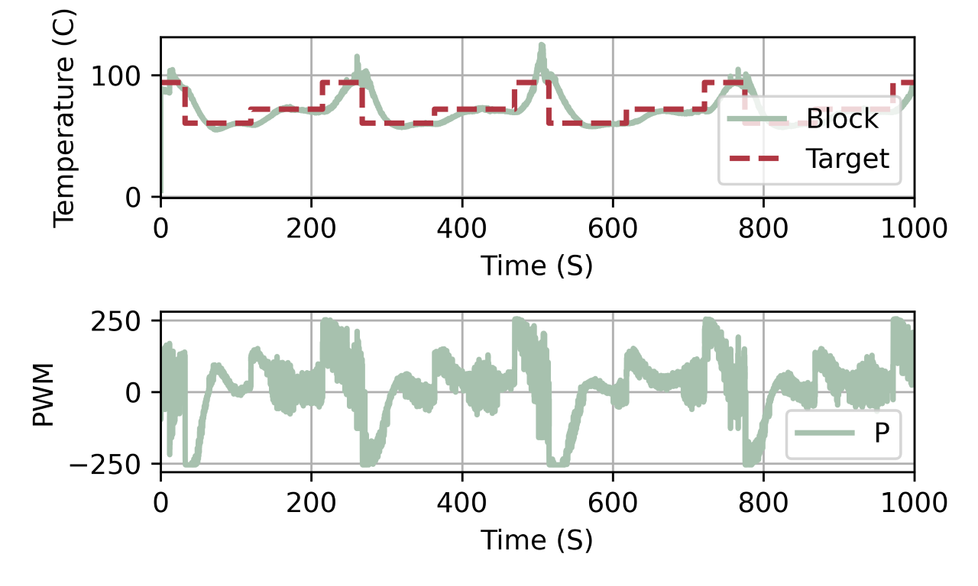
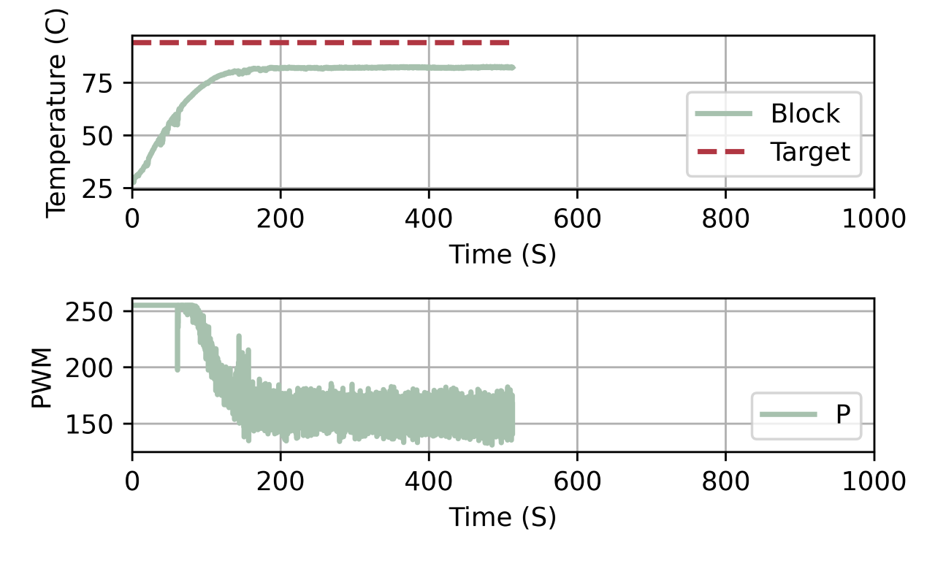
Thermal Performance Issue
Feb 13, 2020
May 22, 2020
The May 22, 2020 never changes temperature because the system was unable to get close enough to the target temperature to trigger the next step.
Temperatures are estimates of PCR tube temperature

Slide 10
Possible Causes
Software problems
Ran both tests using the same software, settings and experiment Feb 13, 2020 commit 4a1461718987835f0 d123c65a39d32330f6f26af.
Thermal Paste Failure
Didn't think of this until after manufacturing the 3rd attempt.
Hardware Failure
Power supply still provides 15V.
Current drivers still output 15V at max PWM.
Peltier MTBF 17,500 cycles [1]. Upper estimated at 8575 cycle (245 days @ 35 cycles).
2% increase in electrical resistance before failure [1].
Ambient temperature
It was about 20ºC when I ran the May 22, 2020 test and I remember it being warmer on Feb 13, 2020.
[1] “Thermoelectric Module Reliability,” Thermoelectric. [Online]. Available: https://thermal.ferrotec.com/technology/thermoelectric-reference-guide/thermalref10/. [Accessed: 26-May-2020].

Slide 11
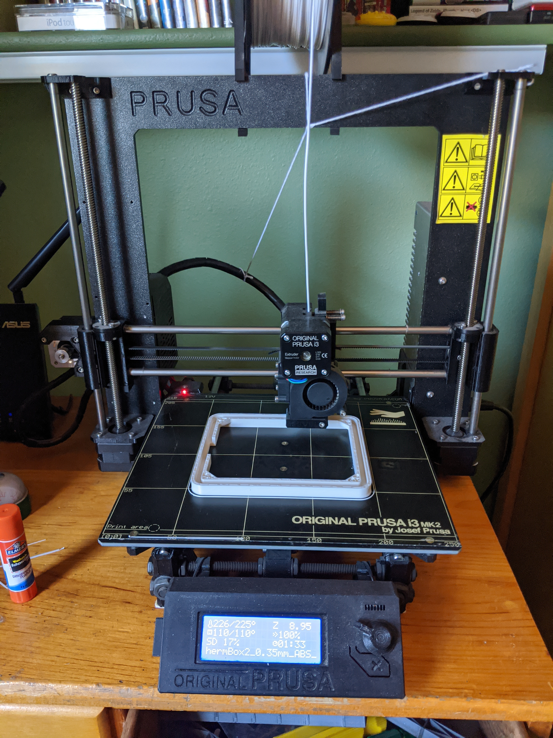


Manufacturing
Materials and Methods
Reflectix Spiral Pipe Wrap 2”
PRUSA i3 MK2
HATCHBOX ABS White 1.75mm
Autodesk Fusion 360
Slic3r PE
2 different printing methods
Standard
Concentric Infill only
5 – 10 times Faster
Somewhat like vase mode but allows for multiple shells
Uses less plastic
Additional design requirements
Harder to print

Slide 12
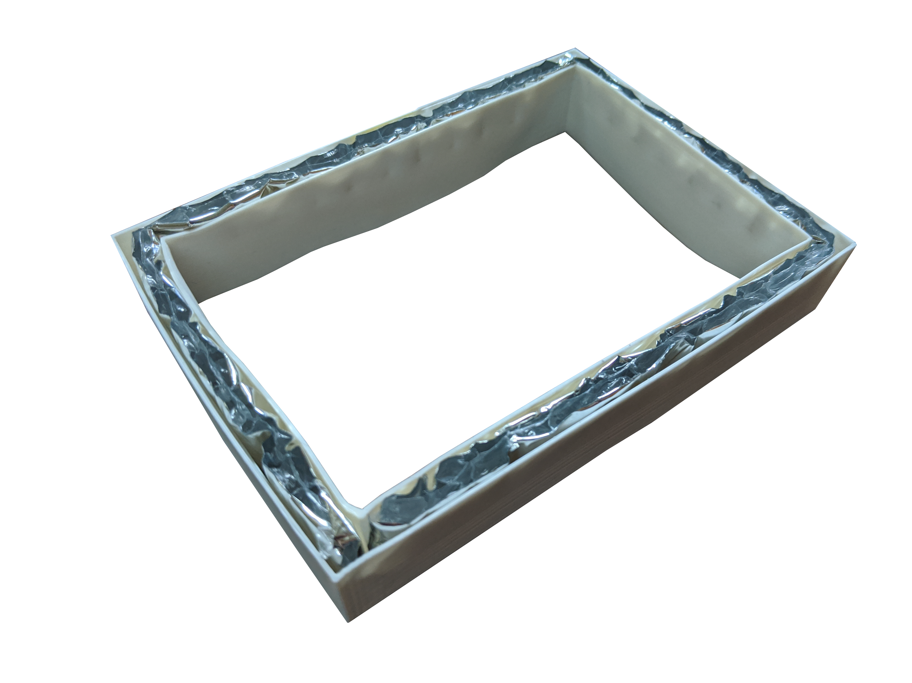
Insulated Thermal Box
Attempt 1
Printed using concentric infill only.
2 0.4mm vertical shells with Reflectix in-between.
Only surrounds the sides of the tubes.
Rests on top of the block and beneath the lid.
No observable effect on thermal performance.

Slide 13
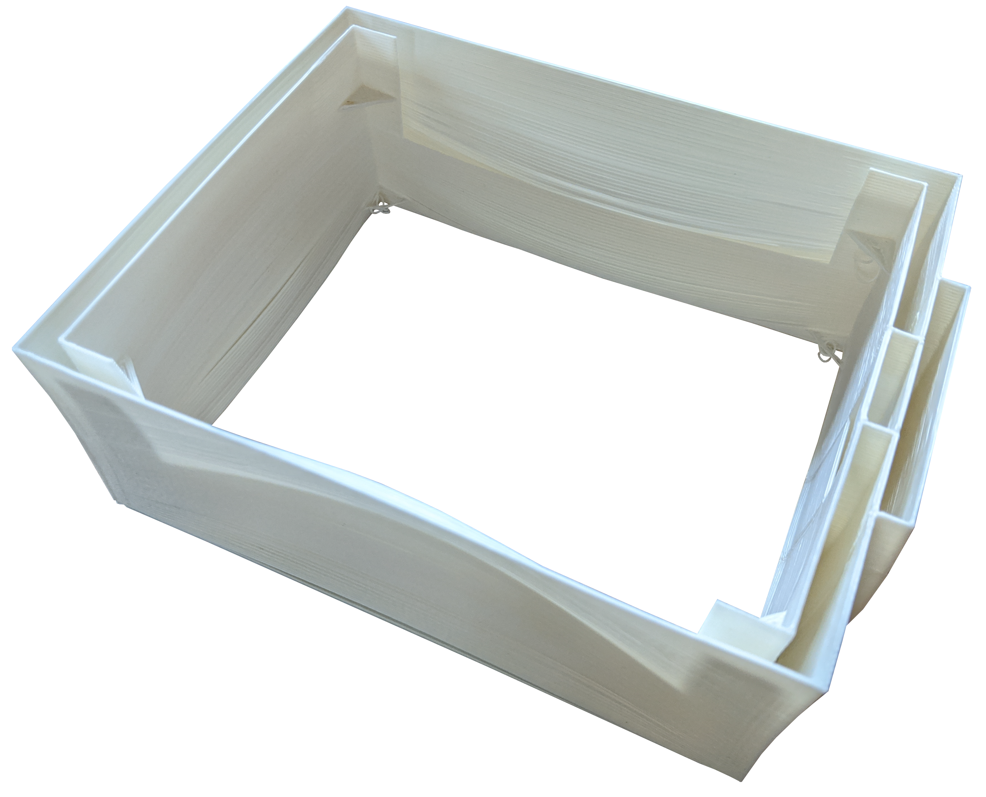
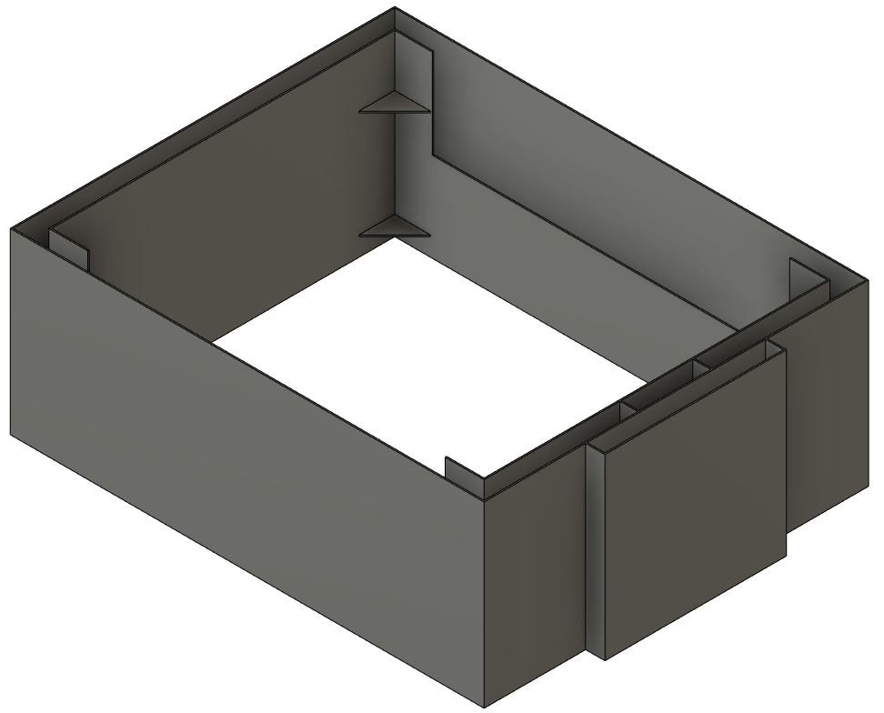
Insulated Thermal Box
Attempt 2
Printed using concentric infill only.
Larger to close gaps with special holes for cable routing.
Failed due to excessive warping during part cooling of long edge walls.

Slide 14
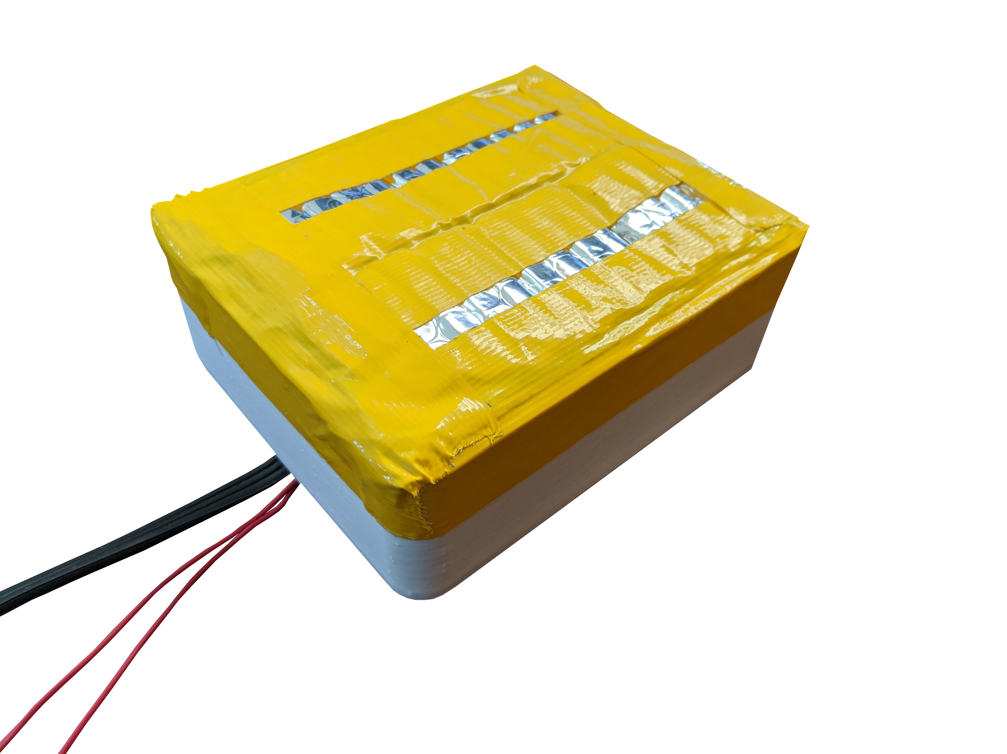
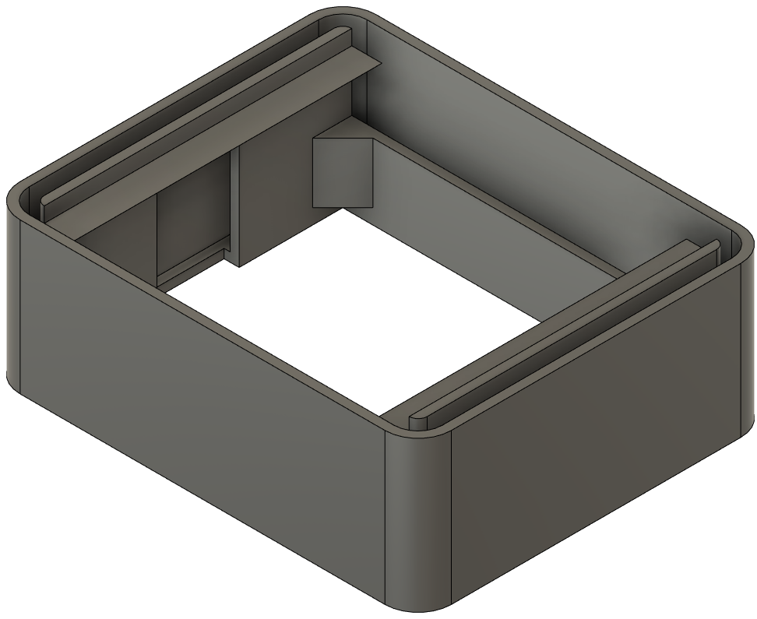
Insulated Thermal Box
Attempt 3
Standard printing methods.
Increased wall thickness to 3mm.
While running the top became warm and the sides remained at ambient.
There is a sub millimeter gap between the interior and the heated block.
The box sits at an angle due to the wires hitting the heatsink.
This design slightly improved thermal performance, but not enough to cycle with settings.
Max temperature reached.
Original Thermal Paste | New Thermal Paste | New Paste with Box
82ºC | 84ºC | 88ºC
Temperatures are estimates of PCR tube temperature

Slide 15
Pre Heating
Another possible cause might be the heatsinks lower temperature.
12711-9L31-09CQ peltiers have a DTmax of 68ºC.
Quick Preheat was performed by running the peltiers at max cooling for one minute.
Slow Preheat was performed by oscillating between 60ºC and 80ºC for five minutes.
Max temperature reached.
Original Thermal Paste | New Thermal Paste | New Paste with Box | Quick Preheat | Slow Preheat
82ºC | 84ºC | 88ºC | 90ºC | 91ºC
Temperatures are estimates of PCR tube temperature

Slide 16
Thank you!
Questions?

Slide 17
